Slide 1
“
I could tell that we took the learning from previous releases and incorporated them into this release. It made such a difference being part of the change journey and having a say in how we handled the change.
Enabling Potential –
Transitioning to SaaS ERP
Marisa Garnero – IMT Strategy + Program Manager
Malcolm Wales – OneCouncil Program Manager
Wollongong City Council

Slide 2
Why an ERP? Wollongong’s Story
2017
IMT Strategy Review + Staff Engagement Survey
Clear feedback that best of breed approach was not working for the customer
Common feedback that a centralised IMT model would better serve our internal and external customers
2018
IMT Redesign
“Oceans 11” team – representatives from all Technology areas of Council
Collaborative design of a structure and service model to meet objectives of IMT Strategy
Opportunity to move to an ERP
Went with TechnologyOne OneCouncil in 2018 and formed core team later that year
“
Moving to OneCouncil allows staff to access information via a single digital system anytime from any location via any mobile device. Creating a more flexible and mobile workforce.
The link between the admin building and depot drops out often…lagging every day. Frustrating!
- User Sentiment Survey, 2017
OneCouncil moves us towards being a City of Innovation as we strive to modernise our service offering and continually aspire to be an Extraordinary Wollongong.

Slide 3
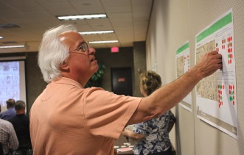
Why an ERP? Wollongong’s Story
Feedback from our Internal Customers…
Mobility for everyone - ability to access everything required
No integration - Multiple systems not talking to each other
Systems are too slow
Objectives
Single source of truth for Council data
Enhanced security of application and information
Reliable anywhere, anytime, cloud-based solution. Flexibility and Mobility
Access to information and business processes anytime
Online customer platform that encourages and facilitates self-service from one fully integrated source (internal and external users), creating a single view of our customers
Decommissioning of on-premise systems – IntraMaps, Pathway, HPRM, Aurion, Hansen
Improved Spatial Integration with OneCouncil Property & Rating
“
Users need a streamlined job management system – our current system is clunky and not user friendly.
- User Sentiment Survey, 2017
Moving to OneCouncil allows staff to access information via a single digital system anytime from any location via any mobile device. Creating a more flexible and mobile workforce.
OneCouncil moves us towards being a City of Innovation as we strive to modernise our service offering and continually aspire to be an Extraordinary Wollongong.

Slide 4
Financials
Supply Chain
(Purchasing)
May 2019
May 2019
Project Management
Request Management
June 2020
Go live 2022
Enterprise Budgeting
Spatial
Enterprise Content Management
May 2022
May 2022
Asset Management
May 2019
June 2020
Click on each image to go to information and training resources relevant to that function.
Established 2019
Work Management
Contracts
& Sourcing
June 2021
June 2020
Property & Rating
Human Resources & Payroll
Performance Planning
May 2022
Asset Accounting
June 2020
May 2019
July 2023
Program Scope – OneCouncil Implementation

Slide 5
OneCouncil – Phasing and Resourcing
Dec 2018 – Apr 2019
Mar 2019 – May 2020
Sep 2021 – Aug 2023
Release 0
(Move to the cloud)
Release 2
Release 3
(Property + Rating, ECM, ECR, Spatial, Contracts + Sourcing)
Revenue Stream
1x Stream Lead
1x SME - Property Management
1x SME - Name and Address / Receipting
1x SME – Debtors
Spatial Stream
1x Stream Lead
2x Technical
Contracts and Sourcing
1x Stream Lead
1x SME - Governance
0.4x SME - Supply Chain
1x SME - Contract Management
Human Resources and Payroll
1x Stream Lead
1x Data Analyst / Technical Resource
1x Technical Resource
2x SME - Payroll
0.6 x SME - Recruitment
0.4 x SME - Organisational Development
Core Team
1x Program Manager
1x Solution Architect
1x Change Manager
1x Support Officer
1x Data Analyst
Core Team
1x Technical
3x Technical Resources
Core Team
1x Program Manager
1x Solution Architect
1x Change Manager
1x Support Officer
1x Data Analyst
1x Training Specialist
Request Management
1x Stream Lead
1x Technical Resource
Release 1
(Ci – CiAnywhere)
Core Team
1x Program Manager
1x Solution Architect
3x Technical Resources
Asset Lifecycle Management
1x Stream Lead
1x SME – Projects
1x SME – Works
1x SME - Assets
ECM
1x Stream Lead
2x SME – Records
2x Technical Resource

Slide 6
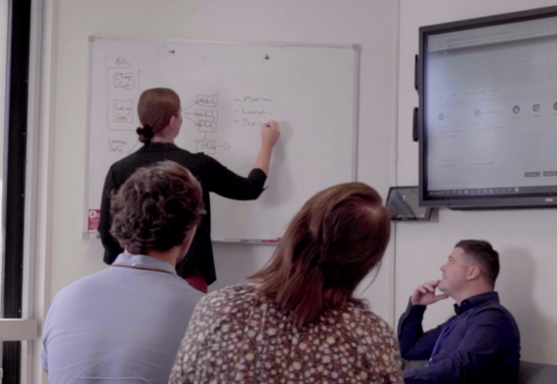
Getting it Done - Program Governance
Steering Committee
Incorporated Senior Leadership responsible for each function
Membership changed with each release
Function and purpose changed with each release – some required more involvement in decisions over time
Became critical with later releases as Organisational Change Management became more of a focus – conduit to highly impacted teams
“
Moving to OneCouncil allows staff to access information via a single digital system anytime from any location via any mobile device. Creating a more flexible and mobile workforce.
A highly engaged steering committee and governance structure led to good advice, support and decisions being made.
OneCouncil moves us towards being a City of Innovation as we strive to modernise our service offering and continually aspire to be an Extraordinary Wollongong.

Slide 7
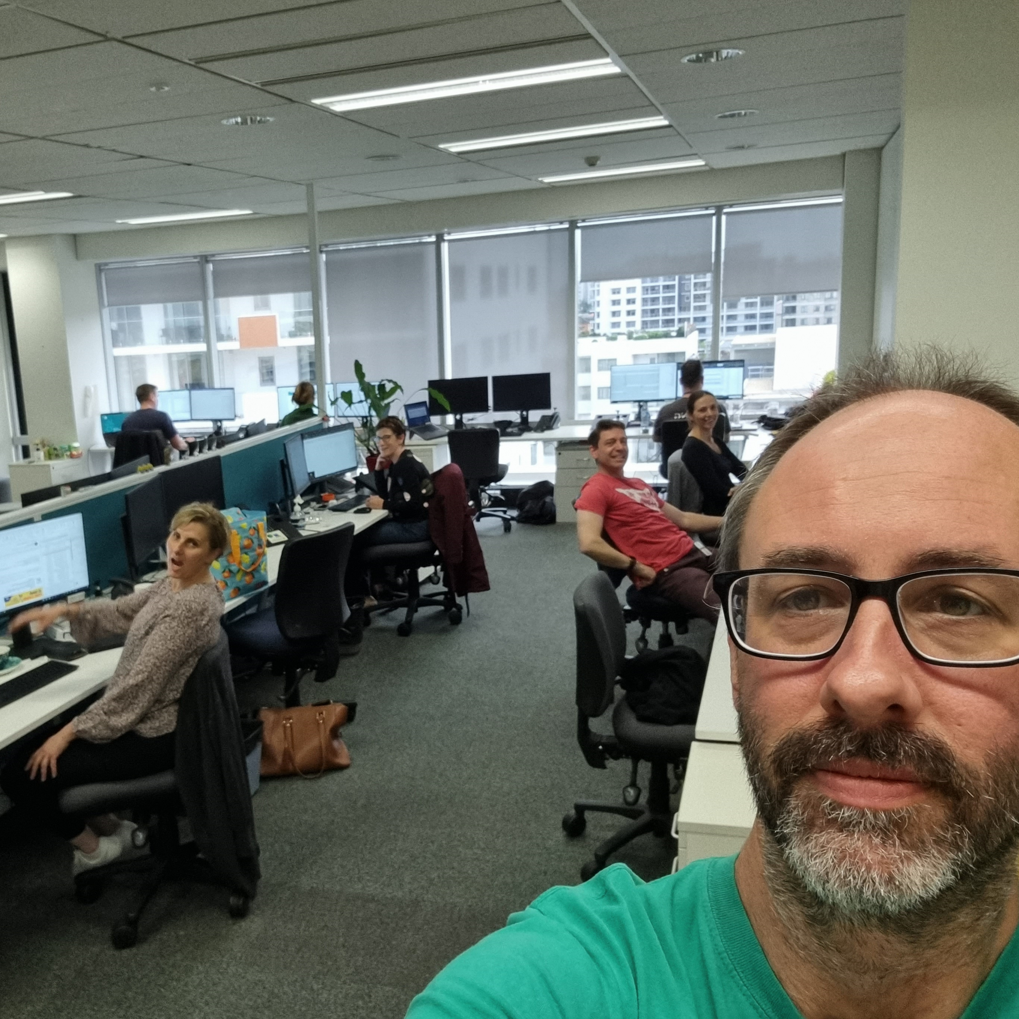
Getting it Done - Program Governance
Core team – Management and Reporting
Daily stand-ups - operational
Weekly Project Status Updates – tactical
Change Control Team – technical change management
Stream Leadership
Reported directly to Program Manager
Task allocation, business engagement, UAT coordination
Resourced from business areas
Combination of technical, Business Analysis and leadership skills
Lesson learned – understand capability and strengths, be careful of putting too much pressure on
“
Moving to OneCouncil allows staff to access information via a single digital system anytime from any location via any mobile device. Creating a more flexible and mobile workforce.
Embedded SMEs in project led to a much smoother rollout, helping to get some really complex processes over the line.
OneCouncil moves us towards being a City of Innovation as we strive to modernise our service offering and continually aspire to be an Extraordinary Wollongong.

Slide 8
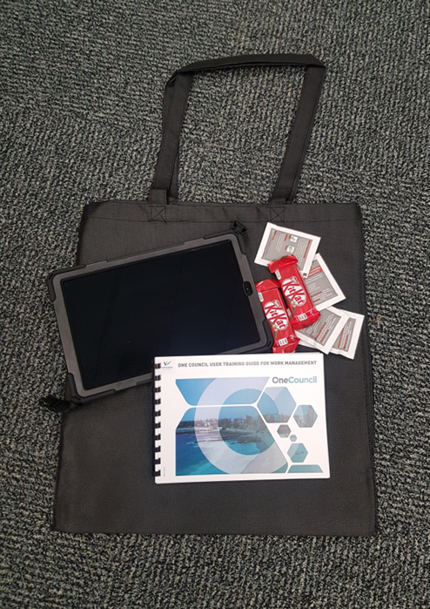
Business Readiness and Change Management
An area of continuous improvement…
Employed a temporary Change Manager for the life of the project – changed 4 times
Lots of lessons learned….
Upfront business engagement – understand business processes thoroughly, early
Often difficult to achieve and maintain engagement from affected areas of the business
Understand impacts of change – even perceived “small” changes
Involve areas of the business directly as part of the Project Team
“
Moving to OneCouncil allows staff to access information via a single digital system anytime from any location via any mobile device. Creating a more flexible and mobile workforce.
Bringing subject matter expertise from the business into the project meant the Project Team had a good mix of business knowledge and technological know-how, modelling our #oneteam approach.
OneCouncil moves us towards being a City of Innovation as we strive to modernise our service offering and continually aspire to be an Extraordinary Wollongong.

Slide 9
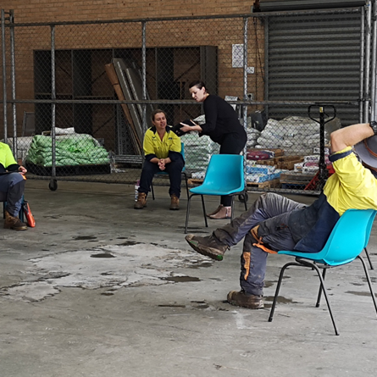
Business Readiness and Change Management
Business Readiness Advisory Group
Formed at the start of Release 3 and HRP release
Regular information sessions to inform and engage
Informed training approach, cutover planning, post go live support model
An “ear to the ground” for areas that may be struggling with change
Hypercare Support
Underestimated business impact during rollout of Request Management – lessons learned informed future training approach
Hypercare model – move away from lengthy structured one-off training sessions to a flexible support model
Drop-in Teams sessions – COVID helped in this regard
“
An online training approach made training more accessible. Staff could interact with content when it suited them and join sessions from any device at any location.
Moving to OneCouncil allows staff to access information via a single digital system anytime from any location via any mobile device. Creating a more flexible and mobile workforce.
OneCouncil moves us towards being a City of Innovation as we strive to modernise our service offering and continually aspire to be an Extraordinary Wollongong.

Slide 10
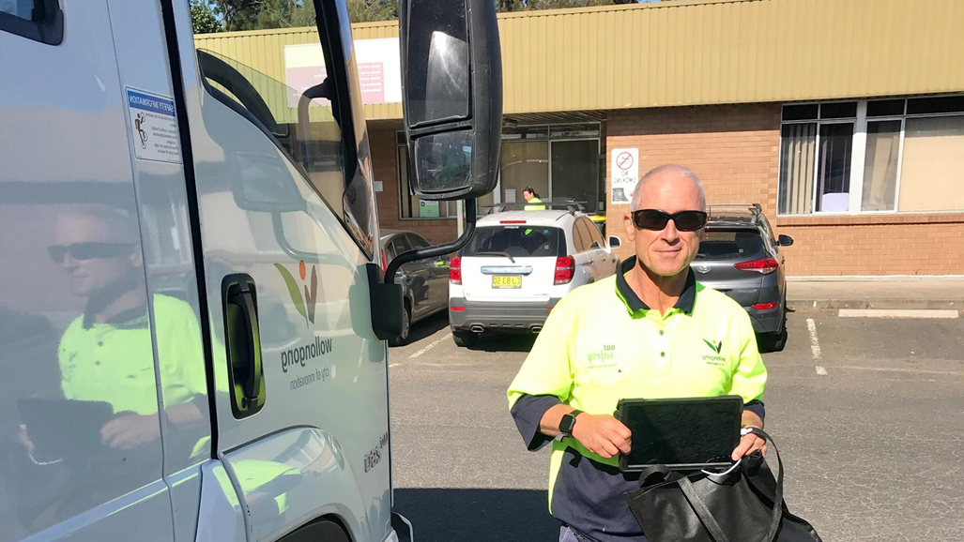
OneCouncil – Release 3A - SNAPSHOT
TIME
Working through a worldwide pandemic that impacted resourcing, resulting in shifting delivery schedules, that saw go-live postponed by six months, with the project going live
23 May 2022
PROCESSES
We moved over sixty application types into OneCouncil, allowing our customers to report, apply and pay through a single online customer portal. As well as migrating over 7.5m records from TRIM to ECM.
SYSTEMS
We replaced three major enterprise systems, PATHWAY, TRIM and INTRAMAPS on- premise. Bringing more core functions in OneCouncil our integrated ERP solution.
“
Moving to OneCouncil allows staff to access information via a single digital system anytime from any location via any mobile device. Creating a more flexible and mobile workforce.
OneCouncil moves us towards being a City of Innovation as we strive to modernise our service offering and continually aspire to be an #Extraordinary Wollongong.
OneCouncil moves us towards being a City of Innovation as we strive to modernise our service offering and continually aspire to be an Extraordinary Wollongong.

Slide 11
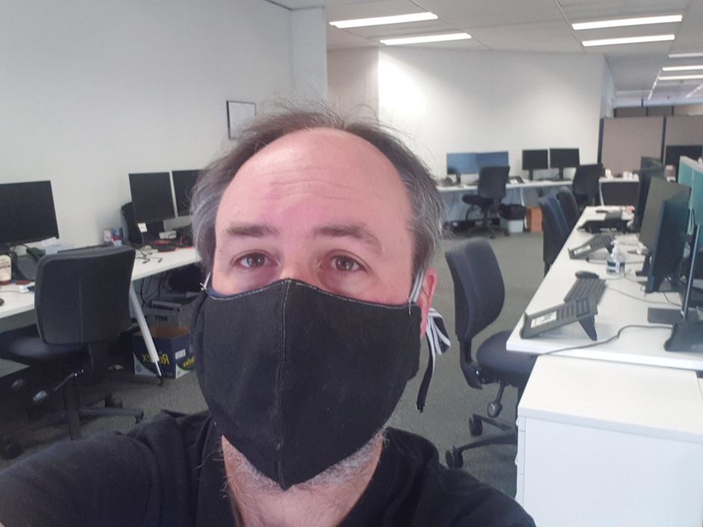
Other Challenges and Lessons Learned…
A worldwide pandemic – launched major system transitions remotely
Environment management – MANY environments to control – testing, training, development, parallel pays, data migration…
Data Migration – don’t underestimate complexity and risk, and skillsets required
Demand management – length of program meant many other initiatives needed to be put on hold or managed in a different way
Digitised services = Digitised support. Don’t underestimate impact on front-facing customer service teams
Field worker impact – also rolled out technology previously unfamiliar to field workers = increased support impact
“
Moving to OneCouncil allows staff to access information via a single digital system anytime from any location via any mobile device. Creating a more flexible and mobile workforce.
Post go live Hypercare support was informative and collaborative…teams were all kept well informed.
OneCouncil moves us towards being a City of Innovation as we strive to modernise our service offering and continually aspire to be an Extraordinary Wollongong.

Slide 12
Video – Ingrid McAlpin, Chief Information Officer
Moving to OneCouncil allows staff to access information via a single digital system anytime from any location via any mobile device. Creating a more flexible and mobile workforce.
OneCouncil moves us towards being a City of Innovation as we strive to modernise our service offering and continually aspire to be an Extraordinary Wollongong.

Slide 13
What’s Next?
Embed and Optimise – reviewing processes and configuration for modules that require it
Implementation of enhancements – both items not within original scope and opportunities discovered post go live
Benefits realisation – measuring and reporting on original objectives and goals
“
Moving to OneCouncil allows staff to access information via a single digital system anytime from any location via any mobile device. Creating a more flexible and mobile workforce.
We need to ensure integrated systems are easy to use and efficient.
- Staff Engagement Survey, 2023
OneCouncil moves us towards being a City of Innovation as we strive to modernise our service offering and continually aspire to be an Extraordinary Wollongong.

Slide 14
Q+A
“
Post go live Hypercare support was informative and collaborative…teams were all kept well informed.
OneCouncil moves us towards being a City of Innovation as we strive to modernise our service offering and continually aspire to be an Extraordinary Wollongong.

