Slide 1
Practical AI: The Real-world Use Case for Delivering Secure Connectivity
Andrew Fox
  HPE Aruba Networking
November, 2023

Slide 2


Andrew Fox
HPE Aruba Networking
Notes:
Welcome, etc

Slide 3

What AI isn’t
Notes:
70s child – idea on AI formed from here
LINK: but as I watch the development, I realise it’s not that dire – here’s what AI is NOT

Slide 4
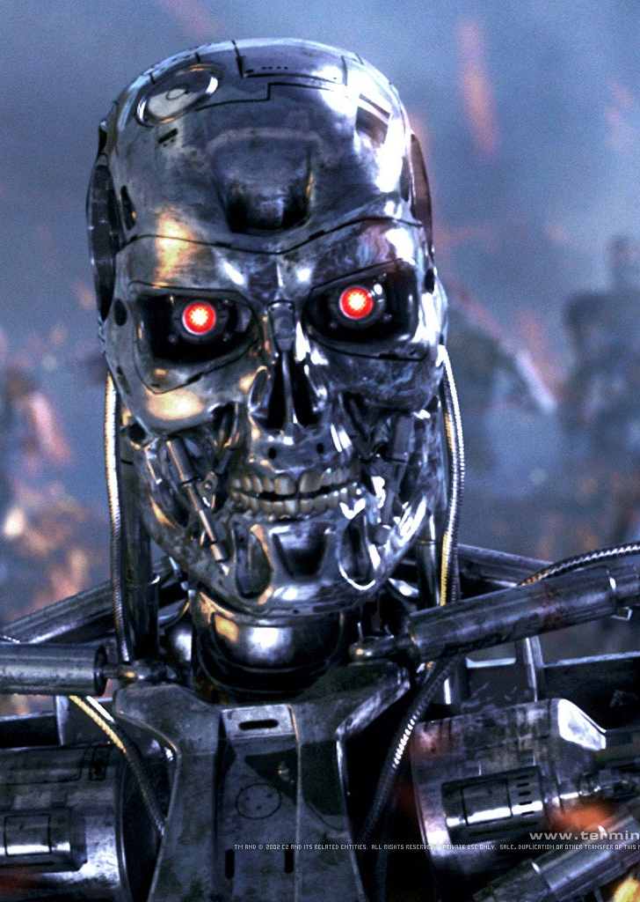


What AI isn’t
Notes:
It’s not evil, plotting total world domination.. Well not on its own
It’s not coming to steal all of our jobs – will it replace some menial admin? Eventually. will it help day to day? Hell yes – especially in networking
It’s not just algorithms and code – it’s not just chatbots looking up a FAQ file – real AI is adaptive and generative.
I’m here today to bust through some of the hype and talk about a few real world areas in networking where AI can really help
LINK: Before we dive in – our job here at Aruba is helping customers with secure connectivity and improving user experience

Slide 5

Deliver Secure Connectivity
People
Notes:
Networking has changed over the last 5 years – coz the way we work has changed
Just getting people connected with 5 bars not enough
Mobility, work from home, bad actors, state-sponsored cyberattacks – this needs a different network
Secure connectivity more important than ever before
LINK: also true that types of devices we are connecting has changed

Slide 6
Deliver Secure Connectivity
People
Things
Notes:
More IoT devices than ever before – so need secure connectivity for people AND things
People are easier – well at least their devices are
Things are harder – probably dumber, simpler, less easy to secure and they are EVERYWHERE
We’ll talk about how to approach that and how AI can help – but
LINK: at the same time, the way we work has changed

Slide 7
Deliver Secure Connectivity
People
Things
On-Prem
At Home
On the Go
Notes:
How do we provide secure connectivity for people and things wherever they are? On site – at home – on the go
And how do we ensure that the user experience isn’t compromised? Locking everything down is great but no good for users

Slide 8

User Experience
Employees
Students
Patients
Shoppers
Guests
Notes:
User experience vital – customers choose you over others because of it
How many people do you tell when the hotel wifi is awful?
LINK: One group that often gets left behind

Slide 9
User Experience
Employees
Students
Patients
Shoppers
Guests
IT Operators
IT Partners
Notes:
..Those running the network.
LINK: Here’s where AI can really help to offload tasks and supplement your team

Slide 10
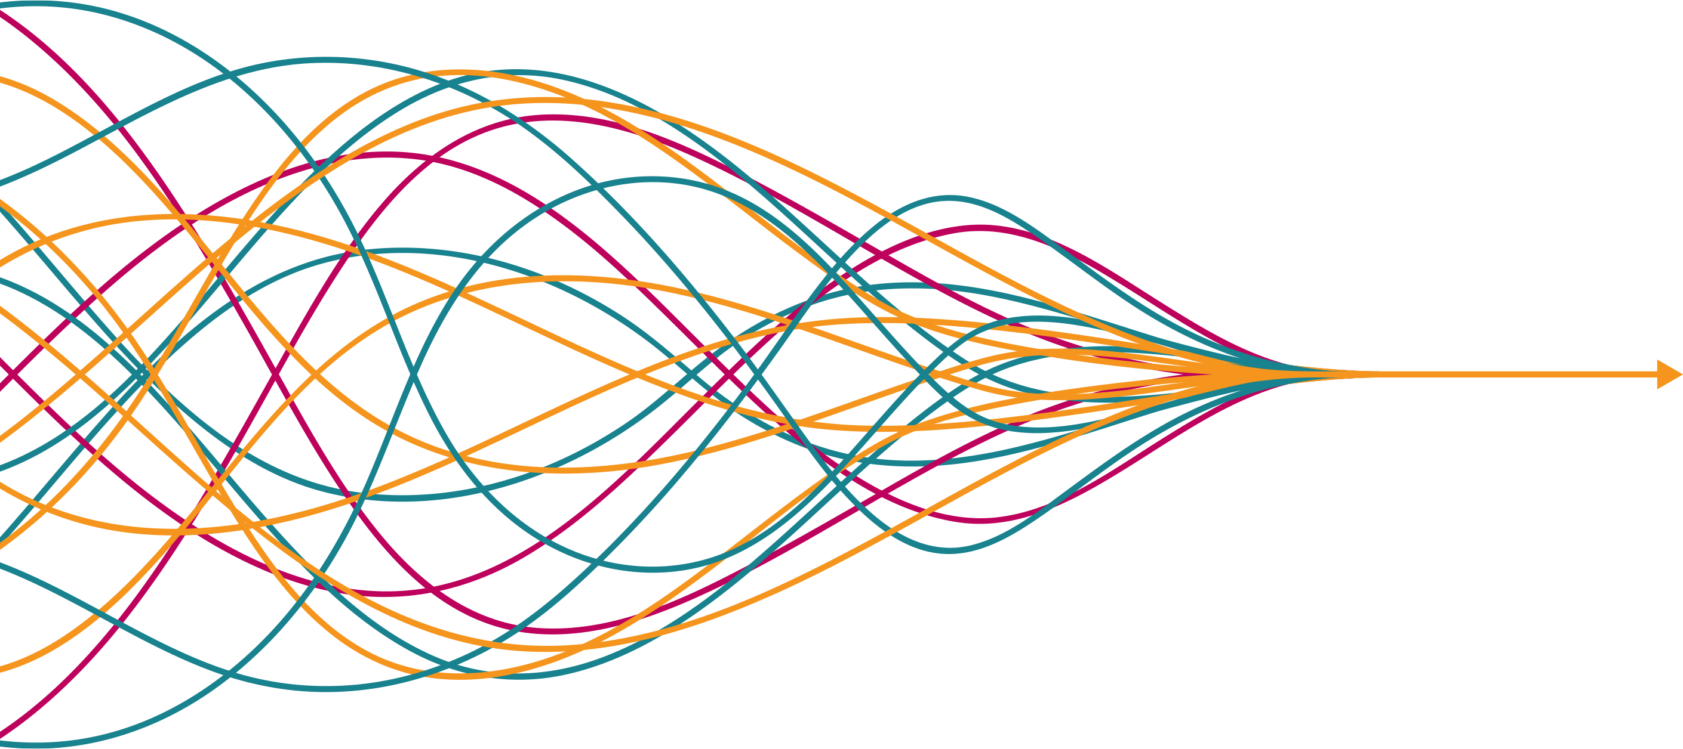
Solving Operator Challenges with AI
Expanded user expectations
Increasing
complexity
Digital transformation
Better outcomes
Faster decisions
Business efficiencies
Richer user experiences
Poor visibility
New business demands
Fragmented tools
Security
risks
Budget and time constraints
Notes:
LINK: over the last 10 years we’ve built an AI-powered platform to help get to RHS

Slide 11




















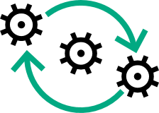







Aruba Central for Cloud-Managed Networking
Unified Infrastructure Management with
AI-Powered Automation
Remote
Branch
Cloud
Campus
Data Center
Central Cloud Management
Adapt
Operational
Financial
(Incremental - Full Refresh)
Deployment
Demand
Network
Technology
(On Prem - Cloud)
(Cost - Performance
Focus)
(Self-Managed -Third-Party
Managed)
(CapEx - OpEx)
Network as a Service
(Consistent -
Peaks / Valleys)
Automate
Location
Onboarding
Provisioning
Management &
Orchestration
AIOps &
Troubleshooting
Analytics &
Optimization
AI and Automation
Protect
Visibility
Authentication &
Authorization
Dynamic
Segmentation
Continuous
Monitoring
Zero Trust
SASE
Edge-to-Cloud Security
Connect
Wireless
Wired
SD-WAN
5G
IoT
Unified Infrastructure
Notes:
We call it Aruba Central – 4 basic layers
AI plays in Protect/Automate layers
LINK: So let’s look at 5 areas where AI can really help

Slide 12
4 Areas AI really helps
Profiling & Identification
Security & Segmentation
User Experience Insight
Problem Determination
Notes:
Anything we can do to offload work from your networking team has got to be good
AI fits well in a lot of places but we see 5 key areas that you can make a difference TODAY

Slide 13
Visibility is hard
80%+
15B+
67%
of IT organisations find devices they did not install or secure on their network
total IoT clients means new devices and more issues on enterprise networks
of IT organisations see network blind spots as a major challenge to data protection
1: Gartner IoT Report
2: Gartner
3: Vanson Bourne
Notes:
You can’t secure what you can’t see. Today’s networks are increasingly complex and figuring out what is on the network – devices that you put there and devices you didn’t – is key
LINK: AI helps us here – to profile and identify every device that connects

Slide 14
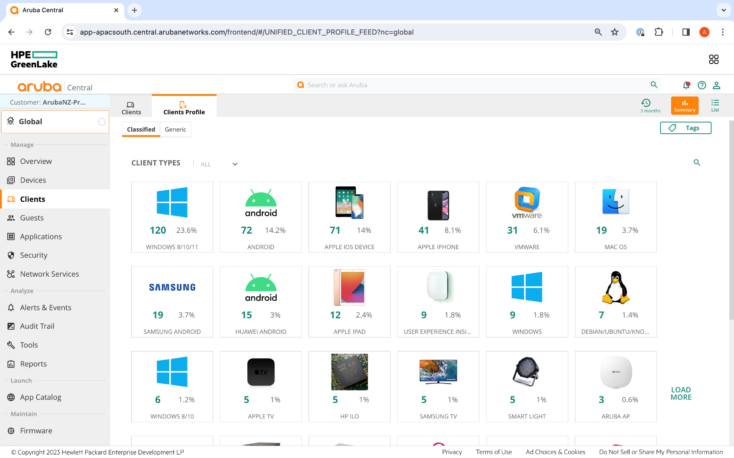
Know what’s on your network
Notes:
We profile the devices so we can understand EXACTLY what they are – and to use policy to assign them a role
What device – what OS – what access should they have
LINK: One thing AI can do that isn’t practical for us as slow humans is to check that devices are what they say they are

Slide 15
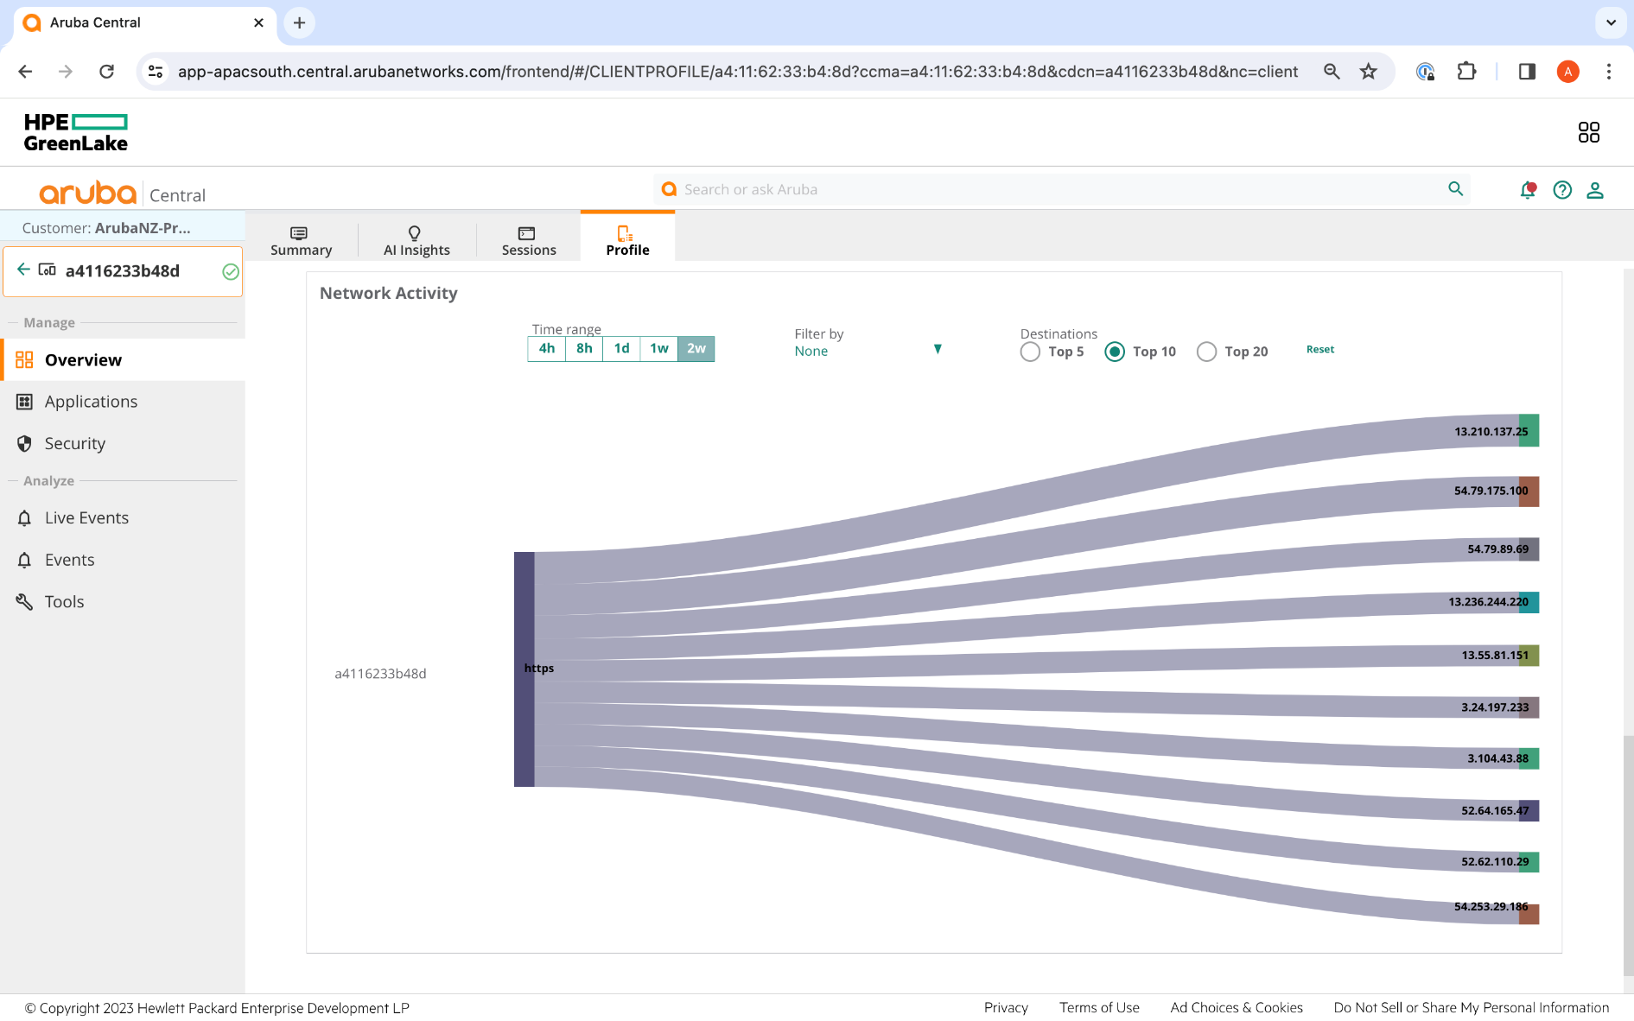
Know what’s REALLY on your network
Notes:
Or behaving as they should. This device SAYS it’s a camera – does it behave like a camera? Is it a bad guy? Is it compromised?
LINK: and then to treat it appropriately – dynamically, with centralized policy

Slide 16
You can’t attack what you can’t see
27%
53%
52%
of business leaders are confident that their organisations are cyber resilient
of employees will work from home at least part time in this post-Covid world²
of IT organisations have experienced a system compromise or data breach in the last year³
1: World Economic Forum - Global Cyber Outlook 2023
2: IDC, Future of Enterprise Networking: Emergence of the New Normal, Feb. 2021
3: Splunk – State of Security 2023
Notes:
We need to be designing networks to maximise safety and prevent lateral movement
Centralised policy, zero-trust principles all play a part in this
LINK: it used to be easy

Slide 17
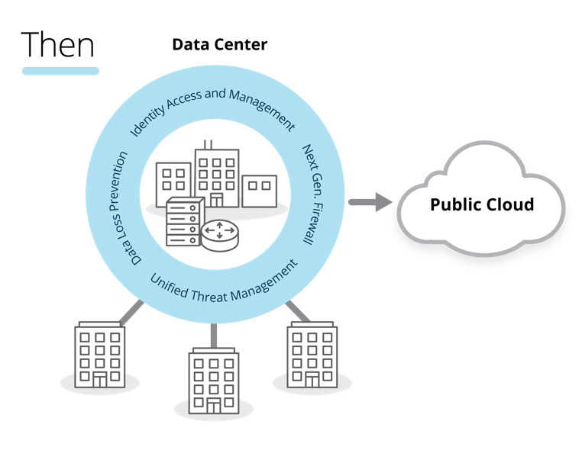
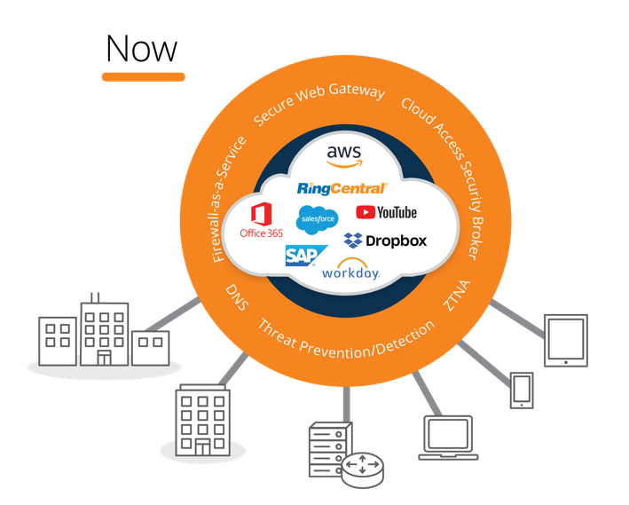

Our world has been turned inside out
The enterprise security perimeter is dissolving
As apps move to the cloud, security must follow
Notes:
Put a firewall right around the outside – and keep the bad guys out
But now our users are out there with the bad guys
And the apps we use are everywhere – onsite, in the cloud
So our security needs to follow

Slide 18








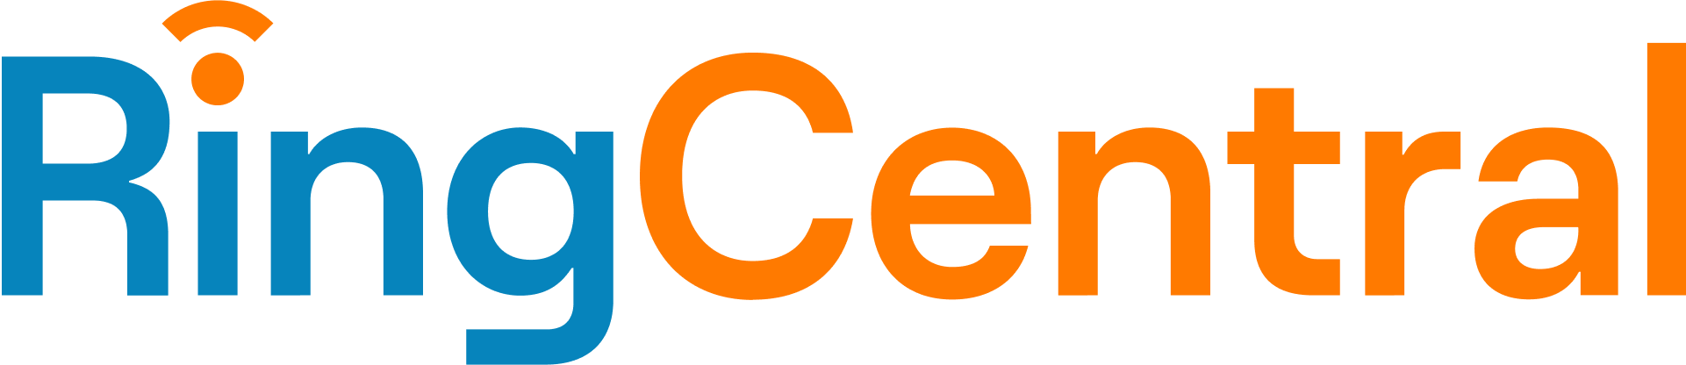




Our world has been turned inside out
Then
Now
Identity and Access Management Data Loss Prevention Unified Threat Managemetn Next-Gen Firewall
Secure Web Gateway Firewall aaS ZTNA Threat Prevention/Detection Cloud Access Security Broker DNS
Headquarters
Storage & Router
Public Cloud
Headquarters
Tablet
Smartphone
Office Branch
Office Branch
Office Branch
Office Branch
Laptop
Storage & Router
The enterprise security perimeter is dissolving
As apps move to the cloud, security must follow
Notes:
Put a firewall right around the outside – and keep the bad guys out
But now our users are out there with the bad guys
And the apps we use are everywhere – onsite, in the cloud
So our security needs to follow

Slide 19

A new world requires a new approach
HPE Aruba Networking SSE
Agent/Agentless ZTNA
Unified policy management
Global PoPs
Security Service Edge (SSE)
Network Access Control
EdgeConnect SD-WAN
EdgeConnect SD-WAN
Secure SD-WAN
Multi-cloud
Improved QoE
Zero Trust &
Unified SASE
HPE Aruba Networking Central NetConductor
& ClearPass Network Access Control
AI-powered client visibility & profiling
Dynamic Segmentation
Continuous Monitoring
Notes:
Onsite – use AI to profile clients and assign roles and security policy dynamically
On WAN – use AI to intelligently steer traffic and avoid requirement to backhaul everything – maximizing user experience
Everywhere – use SSE to inspect, granularly control access to applications without VPN leveraging policy, posture
Things are simply moving too fast and are too complex – AI really helps us here
LINK: the next area that we can lean on AI is for insight into User Experience

Slide 20
A good user experience is key
68%
$4,000
70%
of employees have experienced a late start to meetings due to technology
per day in productivity is lost due to poor performance of critical apps
of IT time is spent troubleshooting user issues taking time from key tasks
Notes:
Networks, especially wireless, used to be a “nice to have”
Now, the productivity of our employees, the experience of our patients, students, customers depends on solid, resilient, secure network
LINK: network team have what seems to be an impossible task

Slide 21


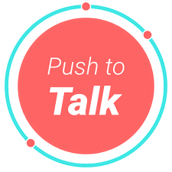


Today’s networks are complex
“Issues go undetected until end-users complain..”
“They’re transient, anecdotal, or difficult to replicate issues..”
Known issues
Transient issues
“Our tools are ineffective and lack end-user awareness..”
Traces
Logs
“Wi-Fi is broken…”
“It chews up all of our time just chasing these weird errors..”
SD WAN
“By the time we get the data the issue has disappeared..”
SaaS Providers
Cloud Providers
Notes:
Once upon a time we had control of all devices – configure them and leave them alone
Now the world is hybrid and complex – IT’s job got infinitely harder
LINK: how can we use AI to monitor and make recommendations?

Slide 22

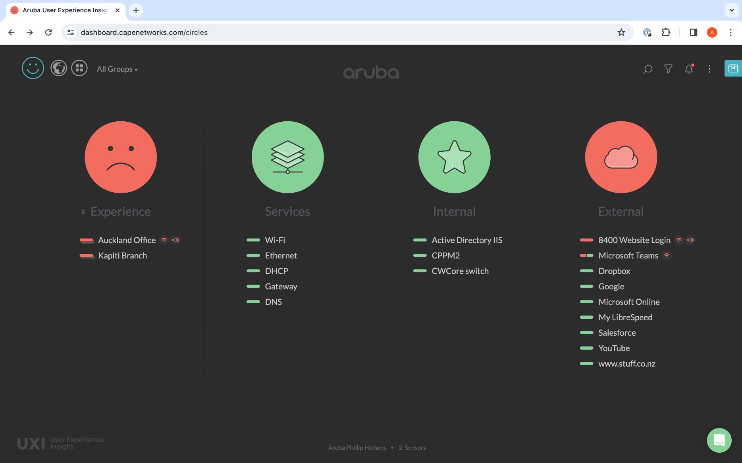
User Experience Insight – no coffee required
Notes:
First, we deploy a sensor. A 24 x 7 network tech who doesn’t need coffee or toilet breaks
Constantly testing applications, benchmarking performance of everything from radio to dns to application performance
We surface everything in a simple, easy to understand portal
LINK: Then, we use AI

Slide 23
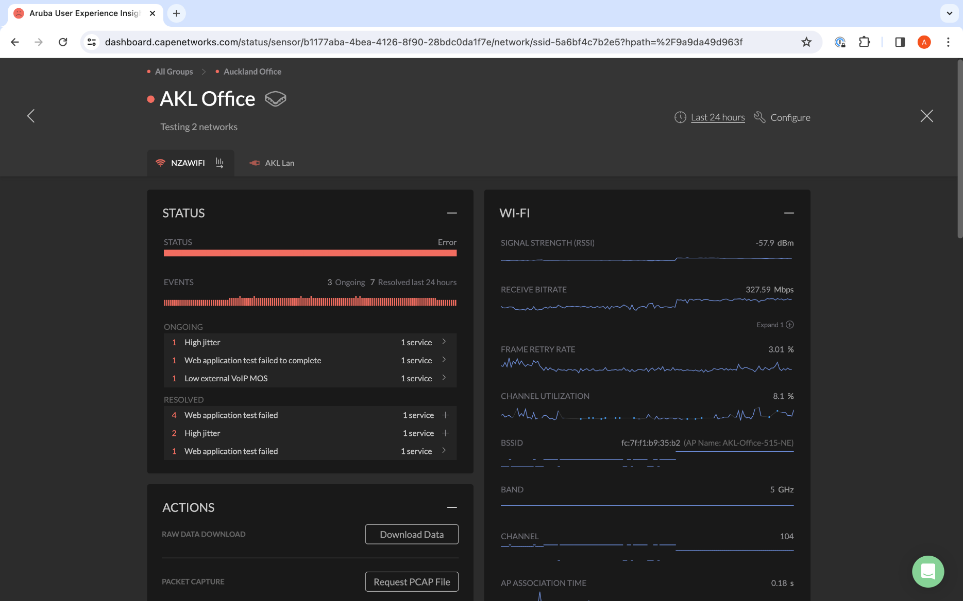
AI-powered Digital Experience Monitoring
Notes:
AI Peer comparisons between sensors, locations allows correlation of issues
AI can determine where probable issue is, regardless of diverse symptoms
Saves HUGE amount of time and prevents truck rolls

Slide 24
Reducing Mean Time To Innocence
65%
20%
25%
of network tasks are done manually today in an average IT organisation
of initial network config will be performed by generative AI by 2026
savings can be realised by leveraging AI for operational network management
1: World Economic Forum - Global Cyber Outlook 2023
2: Gartner
3: Splunk – State of Security 2023
Notes:
Hands up if your network team is overresourced? Has too much time on their hands?
LINK: As an ex-engineer, this is the area I’m most excited about

Slide 25






How can AI help my already overloaded team?
Solving Problems
Quicker
Correlating multiple data sources to centralise problem identification
HPE Aruba Networking Central
Minimising trouble ticket false positives
Resolving Level 1/Level 2 support issues
Automated recommendation / response for complex issues
Notes:
AI can help solve problems quicker – correlate, determine most probable cause
Convert the 24 different errors into a single issue and recommend remediation
Can also do peer comparison – would take us months to compare

Slide 26
Feeding the AI
Data is key
3.4M
Device Model, SW Version, Path Loss, SNR, PoE, Port Flaps, Port errors, Tunnel, Uplink performance, Routes, DPS
Telemetry from all HPE Aruba Networking devices and clients
– Includes state, stats, events, app flows,
– configurations, and topology
Intelligent edge pre-processing
– Reduces volume of telemetry to key features (adaptively)
Rich and diverse
– Adaptive and continuously enhanced
Unified infrastructure/cloud benefit
– Allows joint modeling across bigger data sets
Devices
1B+
Mobility, Capability, SNR,
TX / RX Rate, Outdoor / Indoor and more, App QoE, Rate
Clients
230K
BW, Channel #, Max/Min Pwr, SNR Threshold, TX Rates, Beacon Rates, PoE budget, STP, VLAN, LAG, Tunnel, DPS, Uplink, Routing
Customers

Slide 27
Thank you
Andrew Fox
foxy@hpe.com
Notes:
That’s really a ”once over lightly” on areas AI can help us
The Aruba team is here all day – PLEASE come talk to us some more about how we can help

