Slide 1

Quicksand to Cloud
Our journey to InTune
LG IT Professionals Conference @ Coffs Harbour November 2023
John Crawford
Chief Technology Officer - ICT
JCrawford@cityofparramatta.nsw.gov.au
Les Pall
Technical Operations Manager - ICT
LPall@cityofparramatta.nsw.gov.au
Notes:
Abstract:
City of Parramatta Council will share their warts-and-all journey from legacy to modern management of end-user compute and mobile devices over the last 5 years including the way in which the challenges and opportunities presented by COVOD-19.
John Crawford and Les Pall will illustrate the of strategic thinking, sourcing, and resourcing that took place to ensure the right architecture and operational outcome.
Examples will be given of the legacy environment (based on using Microsoft SCCM / obsolete version of Windows 10), its challenges and constraints, the new environment (Microsoft InTune/ AutoPilot / Windows 11), including the pain of using legacy apps such in such an environment)

Slide 2

Acknowledgement of Country
Notes:
I acknowledge the First Nations traditional owners of the land on which we meet today, as well as the Darug Peoples, who are the traditional owners of the land and waters on which the City of Parramatta Council stands.
I pay my respect to all their elders, past present and emerging.

Slide 3
Agenda
The journey to InTune – why?
Some history
SWOT – or COVID19
Strategy – and its evolution
First attempts
Refinements
Lessons learnt
Notes:
City of Parramatta Council will share their warts-and-all journey from legacy to modern management of end-user compute and mobile devices over the last 5 years including the way in which the challenges and opportunities presented by COVOD-19.
John Crawford and Les Pall will illustrate the of strategic thinking, sourcing, and resourcing that took place to ensure the right architecture and operational outcome.
Examples will be given of the legacy environment (based on using Microsoft SCCM / obsolete version of Windows 10), its challenges and constraints, the new environment (Microsoft InTune/ AutoPilot / Windows 11), including the pain of using legacy apps such in such an environment)

Slide 4
Why?
Because “quicksand”!
Notes:
In business school they teach you - If you’re going to do anything, start with understanding “Why” – otherwise there is no reason to do it.
For us, the “why” was simple:
Endpoint management of our end-user device fleet (iPads, iPhones, Android Phones and user PCs) was in trouble, like standing in quicksand.
We were sinking to a certain disaster.
If we acted the wrong motions, we would sink rapidly.
If we managed to float we could get out of it, just a little dirty
The choice was easy to make and hard to deliver.

Slide 5

A short history of End-user devices at CoP
April 2019
  ~1100 office staff, ~900 using SFF desktop PCs, 60 Civil Engineers using HP Workstations, ~250 using laptop PCs, all managed with SCCM. Claimed “Future Ready” SOE design (actually locked W10 1607, no Windows servicing since 1607). ~600 Mobile devices ad-hoc managed using Apple Config Manager; ABM + InTune.
  Time to change SOE – 6 months – single expert SCCM resource in Infrastructure team.
  Time to manage / configure mobile devices – 1 week (single non-expert resource in Service Desk).
  Configuration Compliance ~= 60% for mobile devices, 95% for PCs
  Provisioning time for new users by Service Desk ~4 hours of high-touch support.

Slide 6
SWOT – or “COVID-19, the gift that keeps on giving…”
Situation – March 2020 Slow-to-deploy PCs Stuck in time (W10 1607) Rapidly had to buy laptops, build/configure/deliver to staff who were used to desktops | Weaknesses “skinny” (250Mbps) VPN, SCCM DP on-premises only. Couldn’t get HP PCs fast enough, had many different models. “Baked-in” SCCM image-based model couldn’t cope with fast change.
Opportunities Chance to change user expectations and due to forced situation Use partners to address capability gaps Move to vendor-agnostic SOE, change Software delivery to Catalogue-driven (UX, Compliance benefit) | Threats Risk of reversion once pressure lifted Technologies (SCCM, InTune/AutoPilot) not at feature-parity, limiting adoption potential Internal resource limits – capability and capacity. Exposed to poor “BS-detector”

Slide 7

SOMETHING HAD TO CHANGE, STARTING WITH THE STRATEGY
“take control” of SOE.
(update to current W10). Resourcing impact. DaaS contract to help implement.
Fix InTune for mobile devices (avert crisis)
PC Fleet Refresh - must be able to use any brand, handle supply chain (COVID-19) issues.
Simplify toolset – whole-of-fleet management
GUIDING PRINCIPLES
Better User Experience
Faster provisioning, “users self-deploy without needing Service Desk”.
Sustainable with our resources
Truly “Future-Forward”, Cloud-first where practical

Slide 8
First attempts
SCCM Cloud Management Gateway took pressure off VPN (June 2020), DaaS contract solved build issues (2020), InTune mobile devices managed, (about March 2021). Began AutoPilot project using internal resources, leveraging prior AVD work that saved us during COVID-19.
Windows 10 (21H2) initially chosen for UX consistency but had to undo SCCM imaging with Cloud Recovery image. Windows app packaging is challenging. Discovered deadlocks, limitations and unexpected behaviours that are different to SCCM.
“Azure AD Join” enrolment – created Configuration profiles to mimic the branding, wallpaper and core apps (VPN client, End-point protection, M365 apps, Content Manager 9.4, InfoCouncil, Adobe and other COTS packages. TechOne Ci (2016 release) and Infor Pathway Smart Client not compatible – tried Remote Apps via AVD.
User experience mixed – users who did not need Pathway / TechOne Ci had good experience but about 50% of staff need them, so had to abandon for all users except Councillors for whom this style of profile is most suitable (M365 apps and end-point protection only)

Slide 9
Further refinements
New leadership (October 2022) – encouraged acceleration of AutoPilot approach and multi-vendor procurement.
Key decision – Split-brain operations - SCCM for servers/ legacy Windows 10 devices only. No co-management. All new devices will be Windows 11 laptops and managed by Intune/AutoPilot only. Expect 100% fleet refresh by June 2024.
First new devices came with Windows 11 – so “JFDI”. User experience – a better Win10, no significant compatibility issues (after we decided to go Hybrid AD Join enrolment profile.
Whilst the foundations were laid with AAD-joined device enrolment using internal resources, Hybrid AD Join is much more complex, internal resource constraint required finding the right partner to assist – in configuration and application packaging.
This was most useful in complex apps that require scripted installers (e.g. TechOne has 6 packages), AutoCAD Civil3D has over 18!). Simple apps (with single MSI) deployed by internal resources. Now have developed “upgrade” capabilities with complex packages.

Slide 10
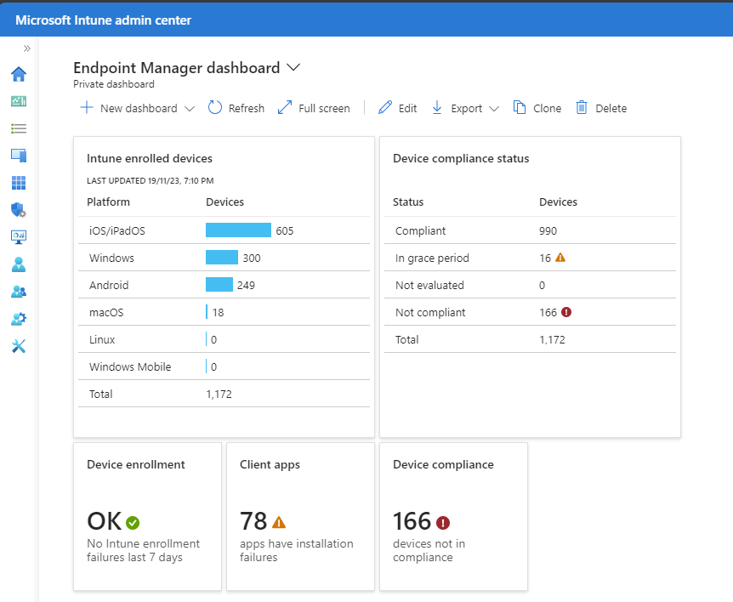
So, where are we now?

Slide 11

LESSONS LEARNT
InTune keeps rapidly evolving and is fit-for-use in comprehensive end-user device management. It’s co-designed with Windows 11 in mind.
Legacy Apps (NTLM auth, COM objects) require AutoPilot Hybrid AD Join. Windows 11 works, do a clean deployment, don’t upgrade in-place.
Don’t try to do it all yourself, use partners – they make a difference!
BE BRAVE
Make bold decisions.
Know your limits
Focus on User Experience
Leverage the right partners
Change PC hardware support models
Keep up-to-date – it’s fast-changing!

Slide 12
THANK YOU
John Crawford
Chief Technology Officer - ICT
JCrawford@cityofparramatta.nsw.gov.au
Les Pall
Technical Operations Manager - ICT
LPall@cityofparramatta.nsw.gov.au

