Slide 1
Best Practice Talent Management

Slide 4
Purposeful Leadership
Human centred, holistic leadership focusing on participants' unique, authentic style. Leadership EQ. Value and purpose alignment. Clear communication.
People Focused Culture
Healthy workplace cultures with high levels of trust and psychological safety. Mentally fit, resilient, high performing, thriving teams. Sustainable change.
Processes for Performance
Eliminating inefficiencies to ignite team passion. Talent management and performance frameworks to Attract, Engage and Retain across the full employee lifecycle.

Slide 5
Low engagement costs the global economy $8.8 trillion. 9% of global GDP. The majority of the world’s employees are quietly quitting

Slide 6
Employer Branding
Attract
Recruit
Onboard
Engage
Offboard

Slide 7
Before Start
Day 1
Week 1
90 days
1 Year

Slide 8
Satisfaction but feeling of uselessness
Delight and fullness, but no wealth
What you
LOVE
PASSION
MISSION
What you are
IKIGAI
What the world
GOOD AT
NEEDS
PROFESSION
VOCATION
What you can be
Comfortable, but feeling of emptiness
PAID FOR
Excitement and complacency . But sense of uncertainty

Slide 11
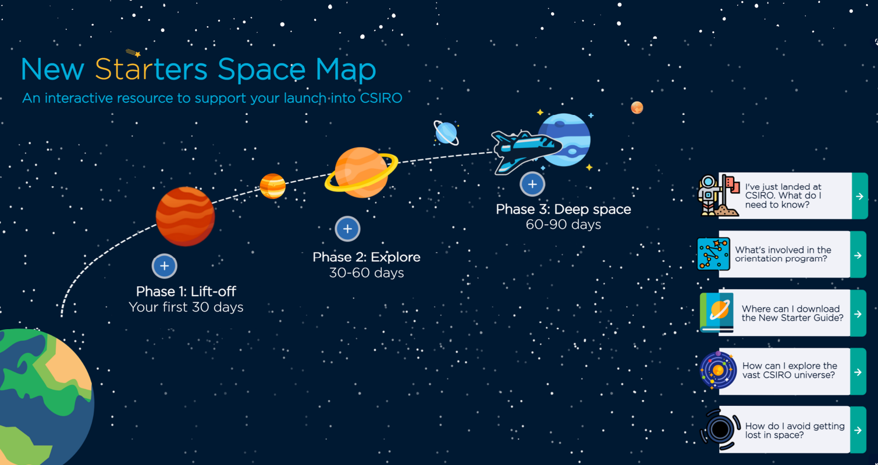

Slide 13
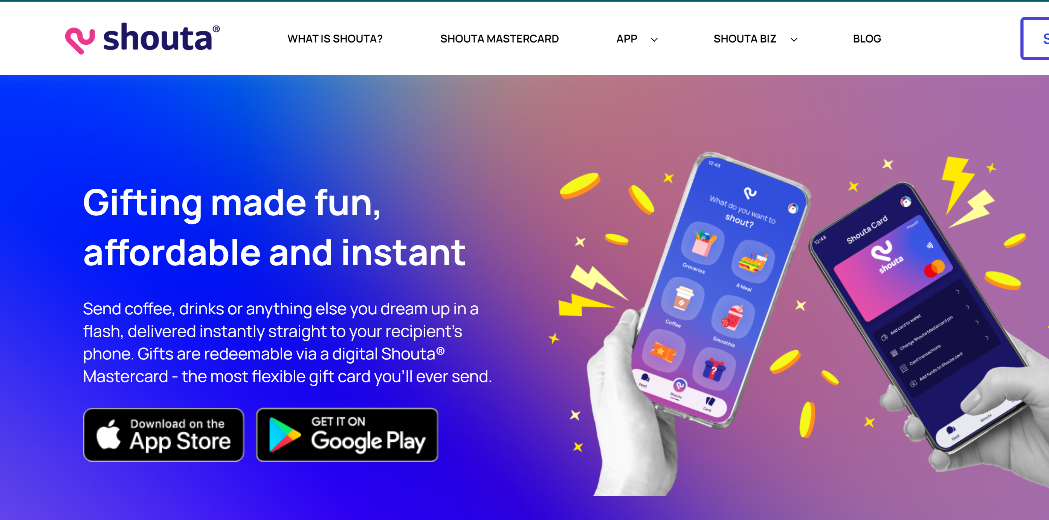
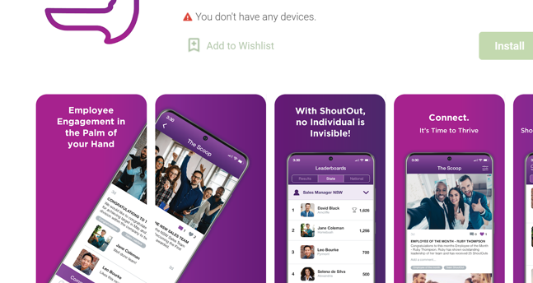
Feeling recognised is a core need for humans
Surf breaks
Friday sundowners
Onsite health services
Employee Assistance Programme
Fitness passport
Giving back/ social responsibility
Pet friendly environment
Team building

Slide 14
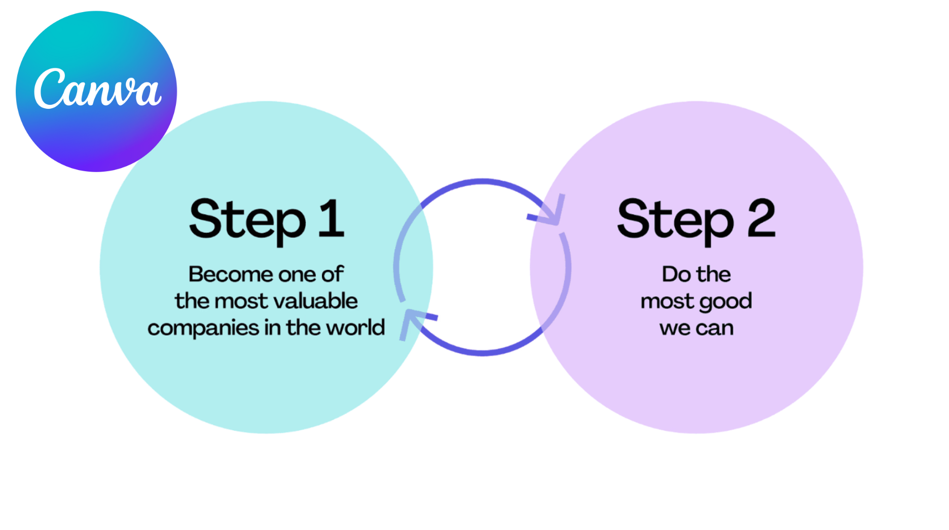

Slide 15
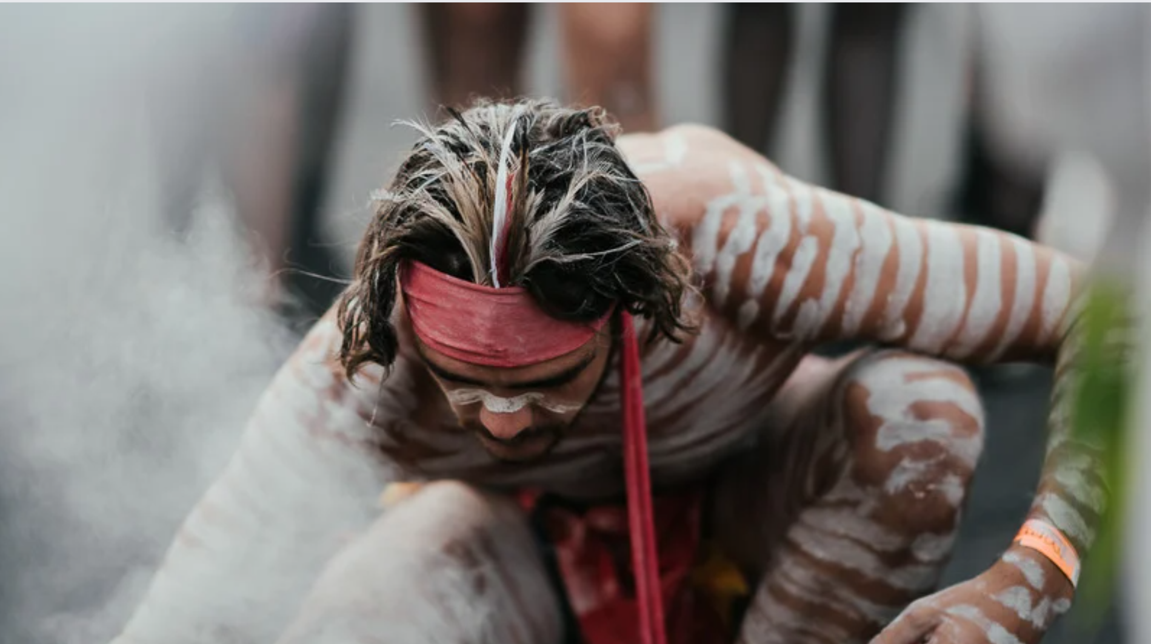

Slide 18
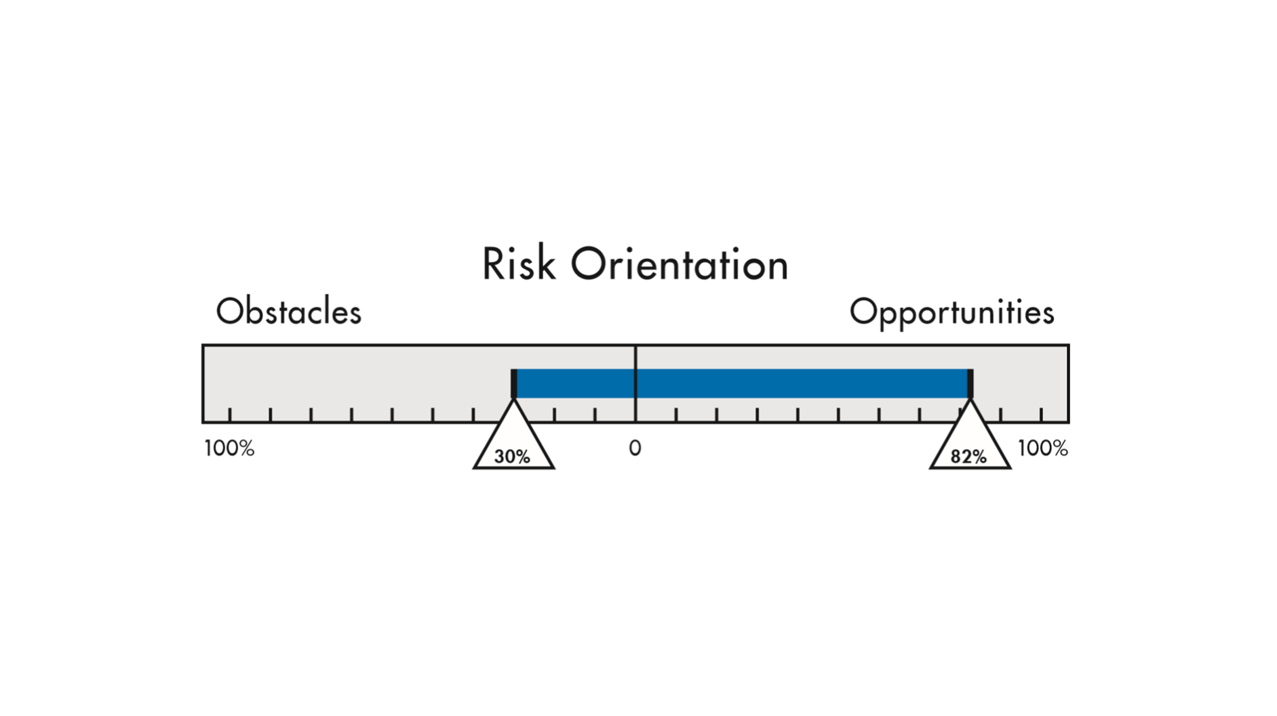
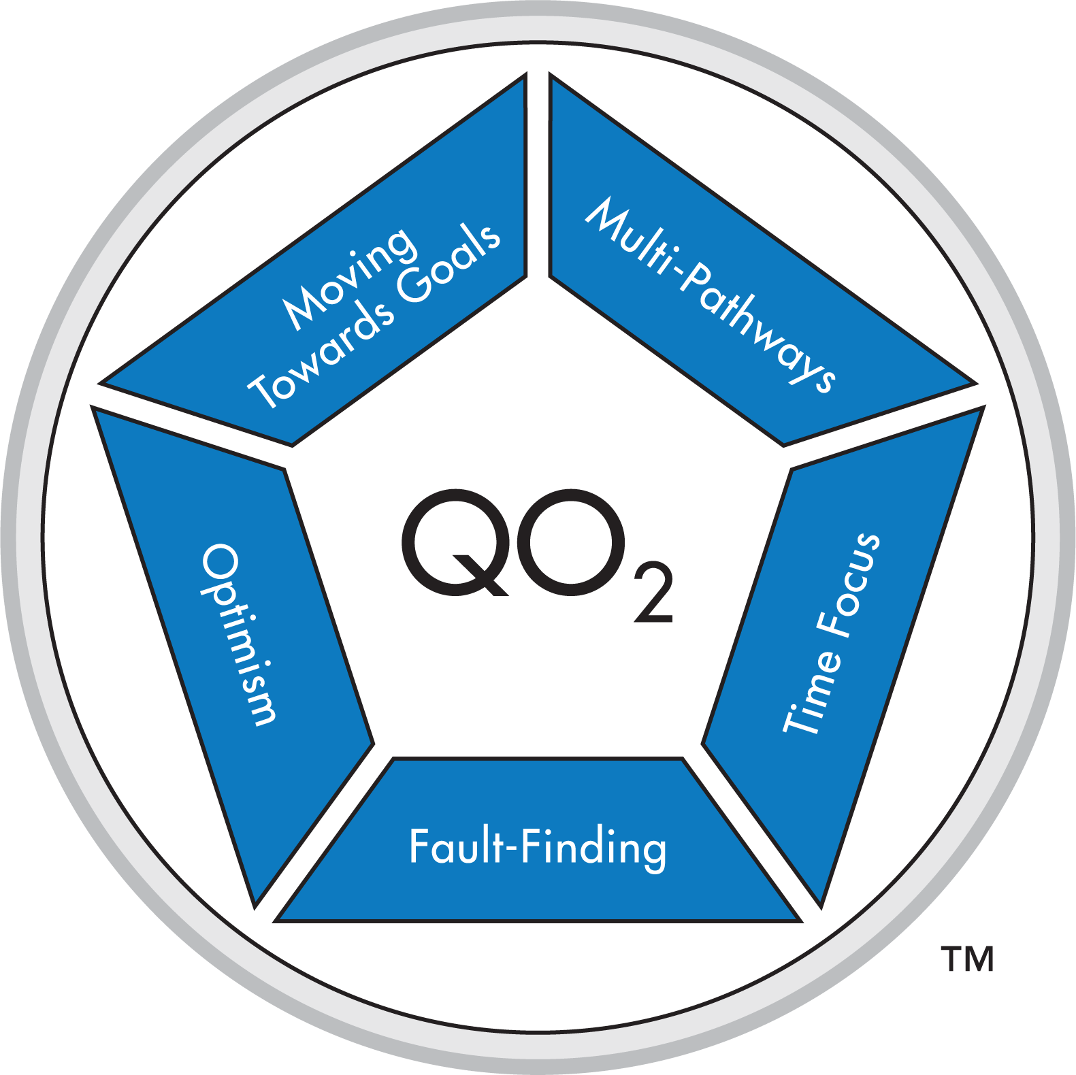

Slide 19
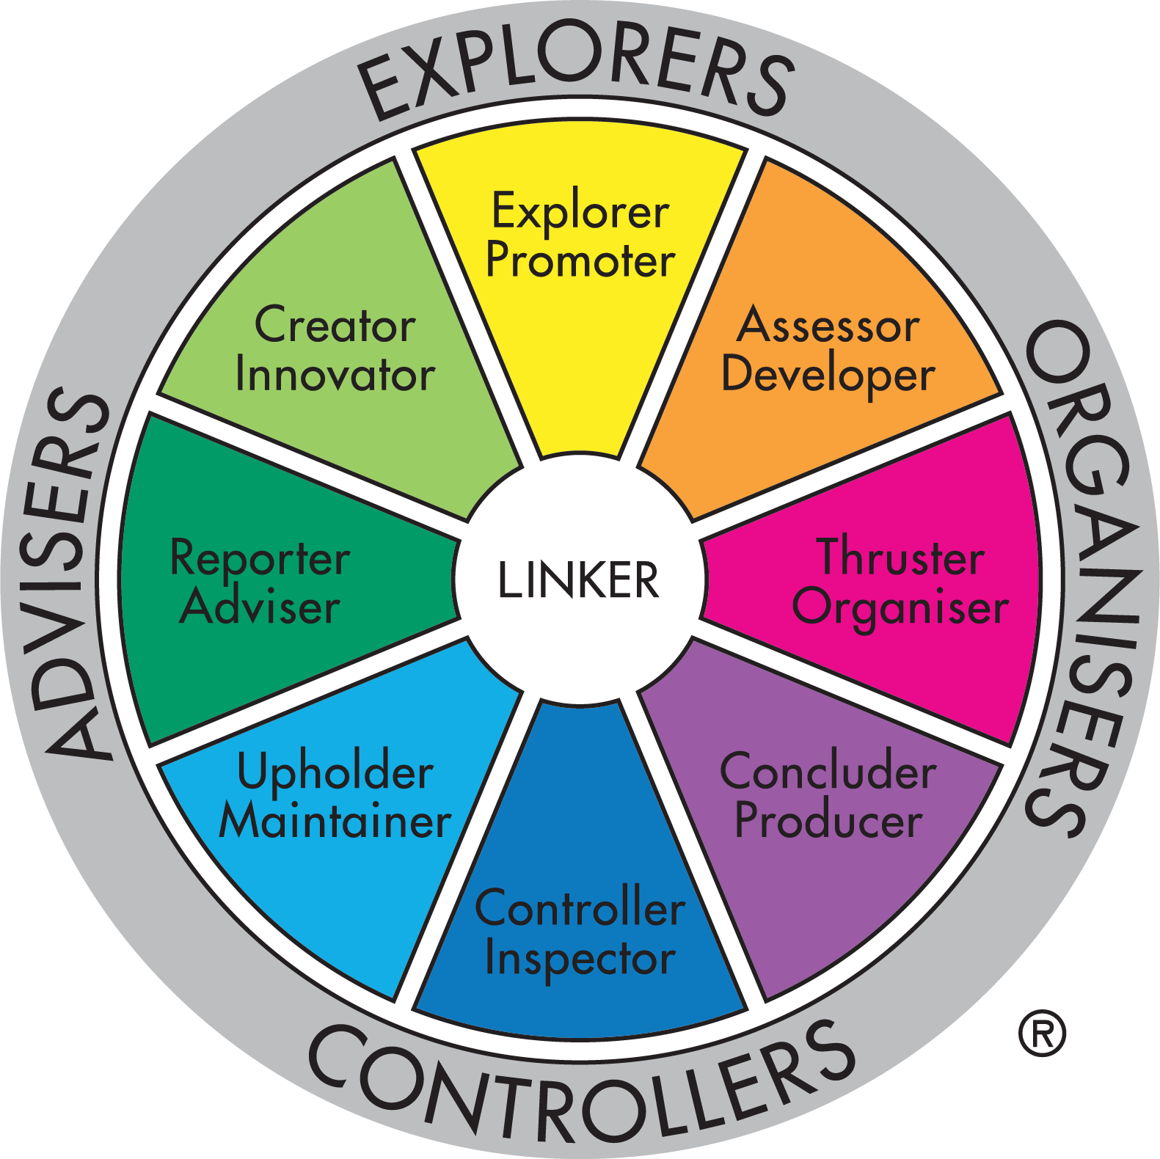

Slide 23
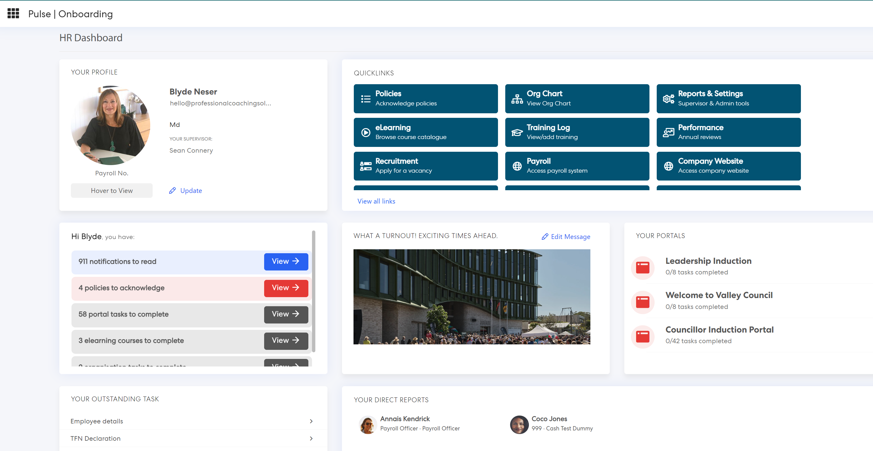
Streamline everything in the talent pipeline with one integrated process

Slide 24
Disparate systems | Paper-based processes
Data Fragmentation Increased Administrative Work Integration Issues Higher Costs Training and Usability Reporting and Analytics Challenges Security and Compliance Risks Vendor Management Change Management | Time-Consuming and Inefficient Risk of Data Loss or Damage Limited Accessibility Higher Costs Environmental Concerns Data Security and Privacy Risks Error-Prone Lack of Integration Inadequate Data Analytics and Reporting

Slide 25
Key Success Metrics
40 Days
Performance Review Completion rate
Online Learning Utilisation
5 Days
Recruitment time to offer
Approval Times
Number of applicants
Payroll Errors
31 Days
2.2 Days
Avg. 8 more per role
20+% increase
25% increase
Notes:
Time to offer
- Mapped the process prior to Pulse and a lot of the delays were with leaders. E.g. someone resigns, position request, advertising text, where do you want to advertise etc
Approval times
More efficient approval times in variations, training and recruitment
Recruitment time to fill down from 41 days to 30.6 days
Payroll Errors
Reduction in payroll error rates due to no longer manually entering data which means the right information always/usually comes through
A. Payroll team mistake or B. receiving the wrong information
More applicants
- They found this fascinating > what they brought this back to is its actually an easier process to apply for a role
- Reimagining the process and removing barriers wherever possible has lead to more and more people applying for roles
- If you are sitting in a space saying “we cant find people” > take at hard look at how you are essentially inviting people to work with you. And also, what is their experiencing during this process and after. How do you wrap it up with them. It is a reflection of your organisation.
Performance review completion rate
- You set a deadline, you ask people to met the deadline and…. No one meets the deadline. So we EXTEND the deadline (and then extend it again!)
Last two years we had 58 and 60% annual performance review completion rate by due date/
This has increased to 85% by the first due date.
Primarily due to the simplicity of the tool.
Online learning increases: 620 digital sessions conducted in the last quarter – increased by 25%.
- Self access of sessions has increased by 75% - people proactively accessing learning – to learn not because they have to.
Do any of you capture these metrics? – You should.

Slide 26
One action step?

Slide 27
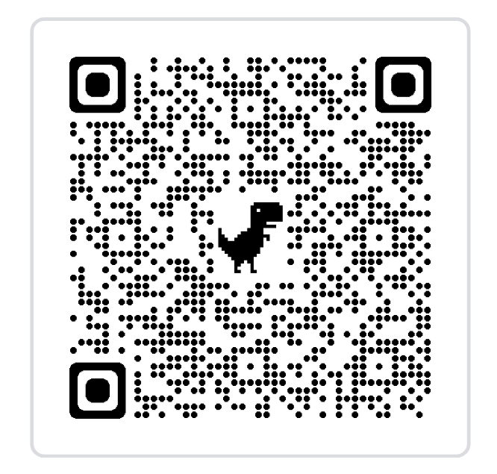
Contact
hello@professionalcoachingsolutions.com.au
www.professionalcoachingsolutions.com.au

